Slide 1




Strategizing to End Gender Apartheid in Afghanistan
A Call to Action
With the support of:

Slide 2
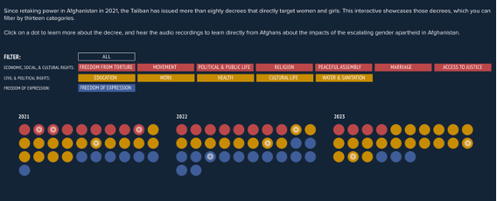
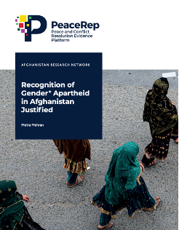
Afghanistan Program
Civic mobilization to end Gender Apartheid
Inside Afghanistan’s Gender Apartheid Platform
Afghanistan Research Network
Arts and Culture Fund
www.civic-engagement.org

Slide 3

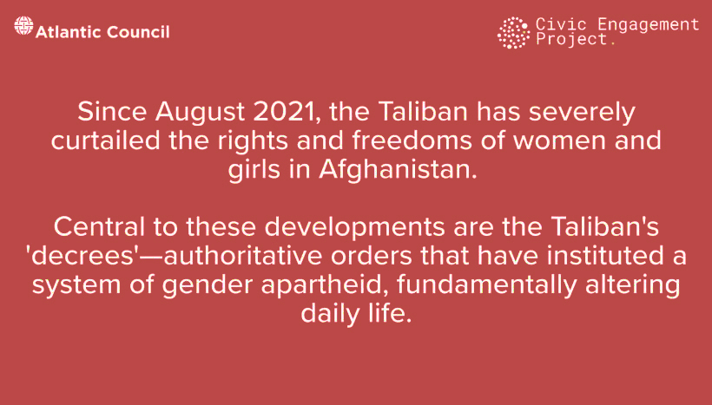
v
Inside the Taliban’s Gender Apartheid

Slide 4
What is Gender Apartheid?
Gender apartheid occurs when a system of governance is deliberately designed to systematically oppress, discriminate against, and subjugate a specific gender group or groups.
This includes laws, regulations, policies, and practices that seek to institutionalize a system of gender-based domination.
Gender apartheid is not yet recognized as a specific crime under international law.

Slide 5
Distinct Elements of Apartheid
Animating Context. An institutionalized regime of systematic oppression and domination by one group over groups
Intent. Intent to maintain and entrench such an institutionalized regime as part of an ideological system of governance
Consequences. Totalizing subjugation that aims to eviscerate any opportunities for individual autonomy and independent advancement

Slide 6
Understanding Apartheid: Historical Context
Apartheid is an Afrikaans term, meaning apartness or separateness.
Apartheid in South Africa was a period of state-sanctioned racial segregation and discrimination from 1948 to the early 1990s.
Black people were subjected to a series of racially discriminatory and oppressive laws, policies and practices curtailing their fundamental rights and freedoms and opportunities for advancement and autonomy.

Slide 7
The 1973 Apartheid Convention
The 1973 Apartheid Convention defines apartheid as:
“Inhuman acts committed for the purpose of establishing and maintaining domination by one racial group of persons over any other racial group of persons and systematically oppressing them.”
The 1973 Apartheid Convention was born out of the experience of apartheid South Africa

Slide 8
Understanding Apartheid: Historical Context
The crime of apartheid was recognized by:
United Nations General Assembly in 1966
United Nations Security Council in 1984
International Convention on the Suppression and Punishment of the Crime of Apartheid in 1973
Rome Statute of the International Criminal Court recognized apartheid as a crime against humanity on July 17, 1998
International Law Commission recognized apartheid as a crime against humanity in 2001

Slide 9
Recognition of Gender Apartheid in Afghanistan: Women’s Long-Standing Fight
Demands for recognizing Gender Apartheid in Afghanistan is rooted in the historical advocacy of Women of Afghanistan and their allies:
Testimonies at the 1998 Tribunal of the Global Campaign for Women's Human Rights.
In January 1999, then-UN Special Rapporteur Abdelfattah Amor stated that the Taliban had “introduced what is in point of fact a system of apartheid in respect of women.”
UN Special Procedures and other UN experts have reaffirmed applicability of the concept of Gender Apartheid in Afghanistan over the years.

Slide 10
The Taliban’s Gender Apartheid Regime
Animating Context
The Taliban have issued 140 decrees, out of which 85 of them specifically aimed at curtailing women's rights - it's more than all other decrees targeting other sectors
The Taliban systematically dismantled all existing mechanisms, laws, policies and institutions designed to eliminate violence and harassment against women.
Women are left without any means of access to justice

Slide 11
The Taliban’s Gender Apartheid Regime
Intent
By dehumanizing and marginalizing women, the Taliban enforces strict adherence to their ideological beliefs, ensuring that any deviation from their norms is punished. This maintains a homogeneous society where dissent is minimized and the dominance of state and men over women is maintained.
The systematic oppression reinforces the Taliban's core beliefs, creating a society that reflects their ideological movement. This helps to instill fear and obedience among the population, preventing resistance.

Slide 12
The Taliban’s Gender Apartheid Regime
Consequences
The consistent application of these control mechanisms, despite any outward appearance of moderation, is crucial for the Taliban's survival. It reinforces their authority and deters opposition
The criminalization of womanhood serves as a tool for practical governance, allowing the regime to exert control over half of the population. It also becomes an existential imperative, as maintaining this strict social order is seen as vital to the regime's identity and continued dominance

Slide 13
The 1973 Apartheid Convention
Recognizing gender apartheid would necessitate accountability for perpetrators, acknowledge the suffering of women of Afghanistan, and prompt international efforts to prevent and punish such acts. It would also strengthen existing sanctions and ensure principled engagement with the Taliban.

Slide 14
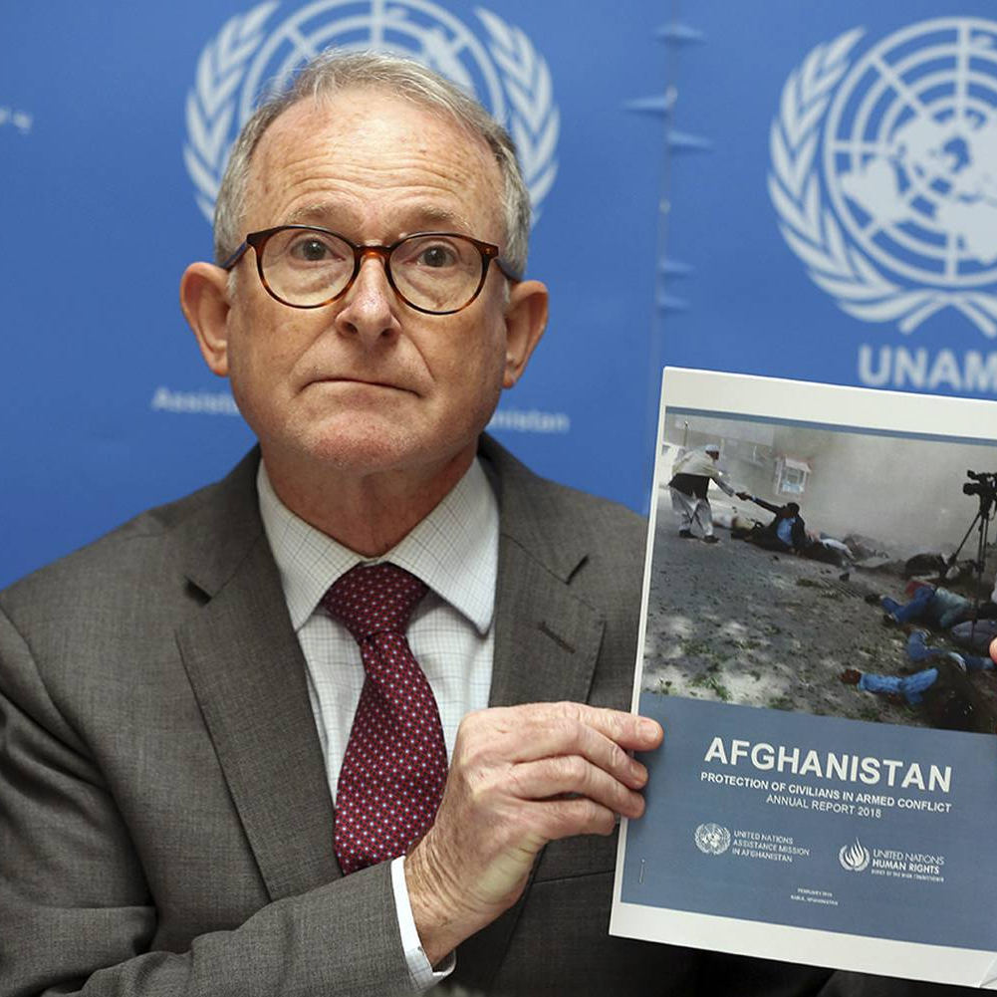
Progress & Milestones
Support from leading figures of the anti-apartheid
movement in South Africa
On June 19, the UN Special Rapporteur on Human Rights in Afghanistan Richard Bennett and the UN Working Group on discrimination against women and girls call for gender apartheid to be recognized as a crime under international law, w/ strong global support.
On Aug 14, a group of independent experts spanning all special procedures of the UN Human Rights Council acknowledged the effort to codify gender apartheid in a joint statement

Slide 15
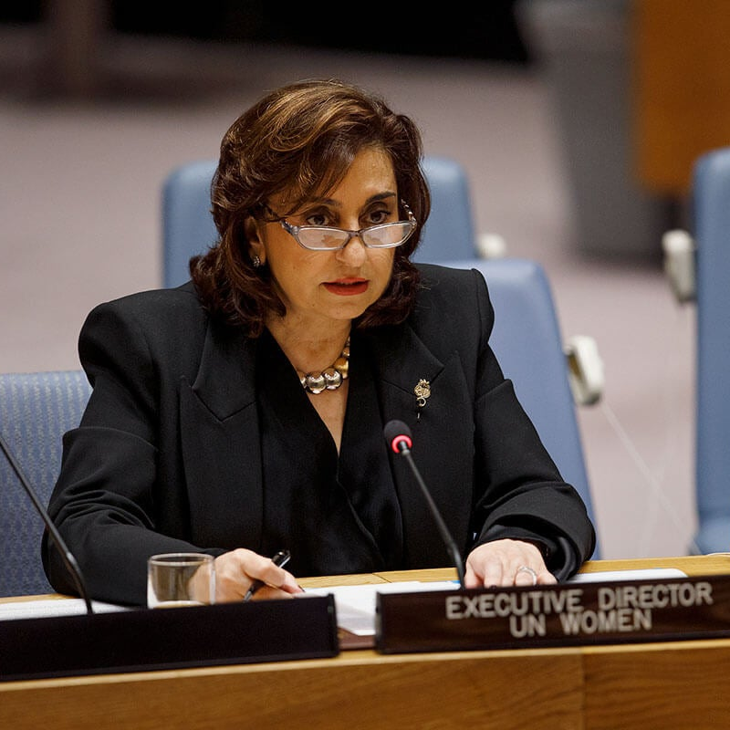
Progress & Milestones
A group of UN experts (Javaid Rehman, UNSR on freedom of opinion & expression, UNSR on cultural rights, and UNWG on discrimination against women & girls) on Sept 1, 2023 saying that the hijab bill in Iran could amount to gender apartheid
In a statement to UN Security Council on Sept 26, 2023, UN Women Director Sima Bahous called on the international community “to explicitly codify gender apartheid in international law”
UN Fact Finding Mission on Iran holding workshops to explore including term in March 2024 comprehensive report
On February 20, 2024, UN experts from the Working group on discrimination against women and girls called for the recognition of gender apartheid as a crime against humanity.

Slide 16
Potential Opportunity for Codification
The UN's Sixth Committee is discussing a proposed Crimes Against Humanity Treaty, which could include gender apartheid. This amendment would provide a legal framework for addressing and punishing acts of gender-based oppression.

Slide 17
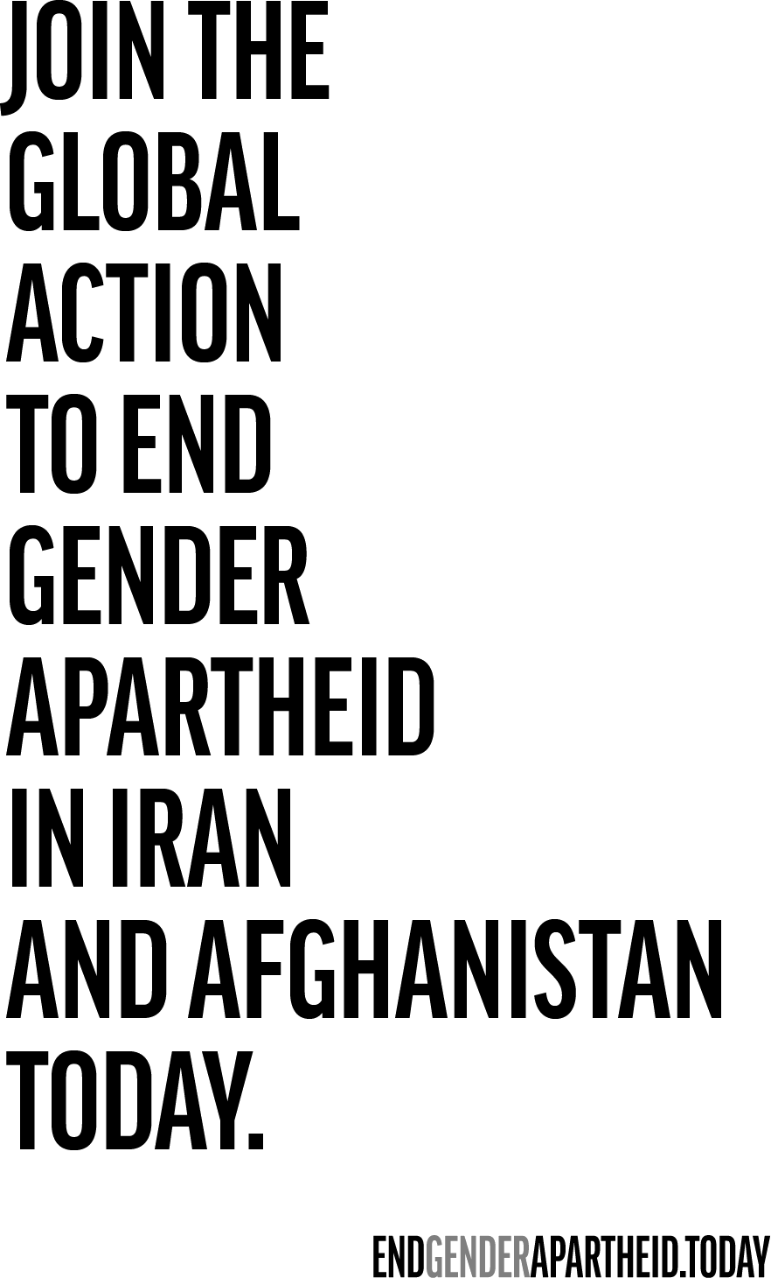
CAH Treaty Timeline
Dec 1, 2023
Jan 1, 2024
Deadline for States to Submit Written Comments on Draft CAH Treaty
Member States' Comments on Draft CAH Treaty to be published
April 1-5, 11, 2024
October 2024
Sixth Committee's second dedicated session to discuss draft treaty
Sixth Committee Decisions on next step for draft treaty

Slide 18
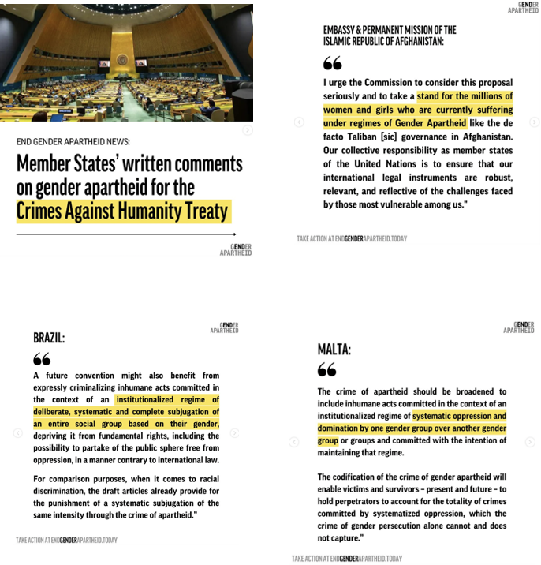
January 2024 Update
In January 2024, the UN published Member States' written comments on a potential crimes against humanity treaty.
Out of 30 comments, 6 specifically mentioned the potential inclusion of gender apartheid as a crime against humanity and 16 raised other gendered considerations.

Slide 19
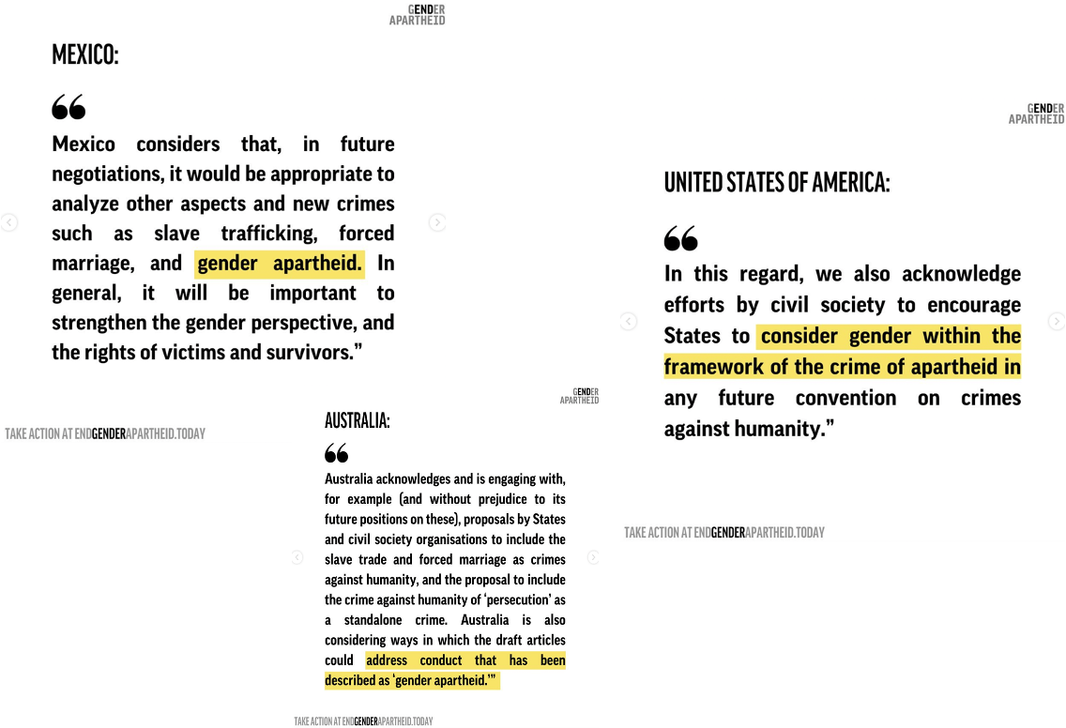
January 2024 Update

Slide 20
January 2024 Update

Slide 21
April 2024 Update
States that supported:
Afghanistan
United States
Australia
Philippines
Brazil
Chile
Malta
Iceland
Mexico
Austria

Slide 22
Implications of Recognizing Gender Apartheid
Necessitate accountability and potential legal consequences. For women in Afghanistan, it would mean acknowledgment of their suffering and steps towards justice.
Recognizes that we are dealing with not just a set of isolated incidents or isolated bad actors, but an entire institutionalized regime that has put discrimination against women at the heart of its governing strategy.
State parties would be obligated to take steps to prevent and punish and not to engage in gender apartheid.
Like in South Africa, codification could prompt and mobilize a coordinated international response using all diplomatic, political, and legal modes of resistance.
Engagement would still be permissible – so long as such engagement does not engage in the acts of gender apartheid.

Slide 23
Implications of Recognizing Gender Apartheid
Acknowledging Gender Apartheid will ensure that our engagement with the Taliban is closely monitored and principled, preventing any normalization or recognition without thorough consideration. It would create an additional layer of due diligence akin to third state responsibility.
Create awareness, raise pressure, and lead to the introduction of new laws that criminalize gender-based violence and provide a legal framework for holding the perpetrators accountable.
State parties will be obliged to adopt legislative, judicial, and administrative measures to prosecute and punish individuals responsible for acts prohibited by the Convention.
Enable any party to call upon the UN to take Charter-based action to prevent the crime of apartheid.

Slide 24
Join the Cause
Educate yourself: Engage in awareness and learning by reading about the issue and discussing it with friends and colleagues. This will provide a strong foundation for advocacy efforts, fostering empathy, mobilizing support, and influencing decision-makers.
Sign the End Gender Apartheid Campaign petition: Join the gender apartheid campaign and support their efforts to raise awareness and promote action. Visit and sign the petition at:
https://endgenderapartheid.today

Slide 25
Join the Cause
Initiate a debate at the national level: Engage foreign parliaments and government institutions in the countries you reside in to recognize gender apartheid and consider its potential codification as a crime of gender apartheid.
Engage with activists during the ongoing UN negotiations: At this critical time, collaborate with civil society and activists to influence UN member states during ongoing negotiations on an international treaty codifying crimes against humanity. Highlight the need to address gender apartheid and its severe consequences.
https://endgenderapartheid.today

Slide 26
Sources
Gender Apartheid Campaign: https://endgenderapartheid.today
End Gender Apartheid Campaign Legal Brief
Professor Karima Bennoune paper
Metra Mehran paper, Recognition of Gender Apartheid Justified
Global Justice Center Fact Sheet on Treaty on Crimes Against Humanity
Atlantic Council and Civic Engagement Project’s Inside Afghanistan’s Gender Apartheid multi-media platform
Civic Engagement Project: www.civic-engagement.org

Slide 27

Thank you
For more information:
civic-engagement.org

